Slide 1
Design of a Simple CPU
11-instruction CPU with 2¹² (4096) 16-bit RAM.
Illustrates how a general-purpose computer is assembled from gates and registers.
The design is simplified to make basic concepts clear.
CPU design can be very complex.
Since the CPU is the heart of every computer, emphasis is put on making it fast.

Slide 2
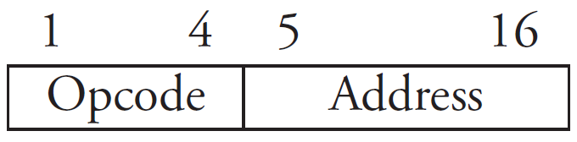
The Register Set
A CPU is a sequential circuit
repeatedly reads and executes an instruction from its memory
fetch-and-execute cycle
A machine language program is a set of instructions drawn from the CPU instruction set
Each instruction consists of two parts: an opcode and an address

Slide 3
11 instructions require a 4-bit opcode.
12 bits of the 16-bit word remain for addressing 2¹² = 4096 16-bit words of the RAM.
The CPU has 8 special registers:
16-bit accumulator (AC)
12-bit program counter (PC)
4-bit opcode (OPC)
12-bit memory address register (MAR)
16-bit memory data register (MDR)
16-bit input register (INR)
16-bit output register (OUTR)
1-bit halt register (HLT)

Slide 4
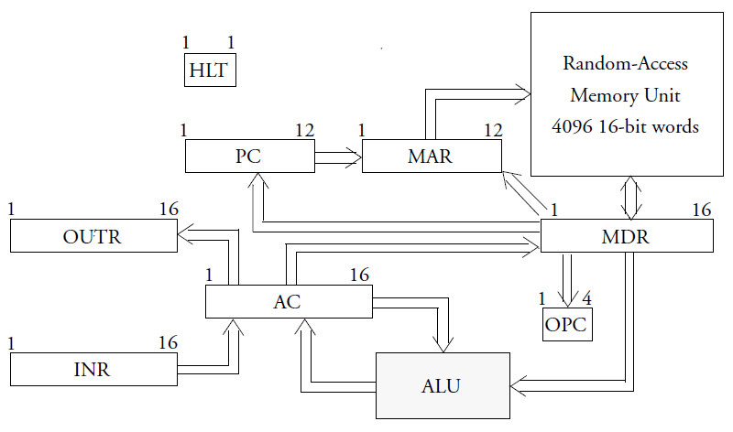
The Registers Data Transfer in the CPU

Slide 5
The Fetch-and-Execute Cycle
Fetch-and-execute cycle has two portions
Fetch portion is always the same:
instruction, whose address is in the PC, is fetched into the MDR
opcode portion of this register is copied into the OPC
At this point the action of the CPU
diverges, based on the instruction in OPC

Slide 6
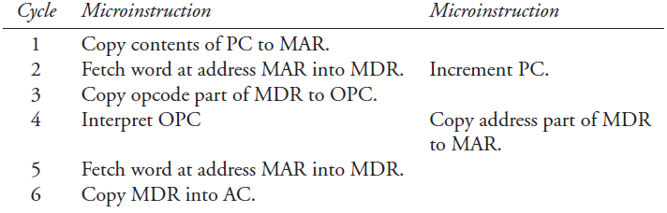
Suppose OPC is a load accumulator instruction.
the action required is to copy the word specified by the address part of the instruction into the accumulator
load accumulator is decomposed into 8 microinstructions executed in 6 microcycles

Slide 7
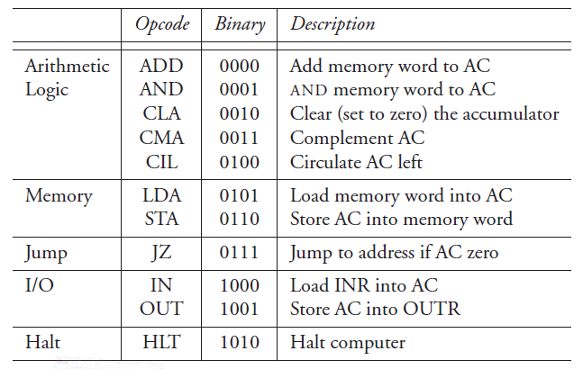
The Instruction Set

Slide 8
Other operations can be performed using this set:
subtraction is realized with ADD, CMA, and 2’s comp
multiplication is possible through the use of CIL and ADD
multiple CILs can be used to rotate right one place, hence division is also possible
AND and CMA are complete Boolean system, hence every Boolean function can be realized by this machine if it is designed to address enough memory locations

Slide 9
This is a direct memory instruction
Addresses refer directly to memory locations containing the operands (data) on which the program operates
CPUs have also indirect memory instructions
Instructions in which an address is interpreted as the address at which to find the address containing the needed operand
CPU does two memory fetches
the first to find the address of the operand
the second to find the operand itself

Slide 10
Assembly-Language Programming
Instructions stored in memory consist of 16 bits.
the first 4 are opcode and the last 12 are address
It is hard to interpret such machine-language statements.
mnemonic opcodes and assembly languages are devised
Assembler is a program translating an assembly language program into a machine language.

Slide 11
Example: a Boot Program
Assembly-language program to boot up a computer is reading another program provided through the input port and stores the new program (16-bit words) in memory just above Boot.
When reading is finished (determined by 0 word), control is transferred to the new program by jumping to the first location above Boot.

Slide 12
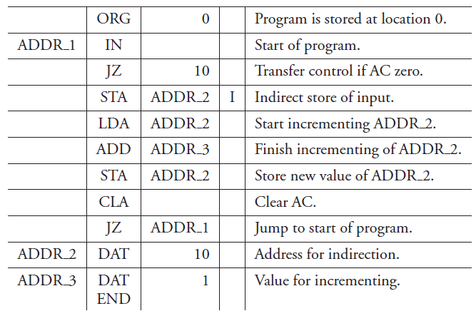
0
1
2
3
4
5
6
7
8
9

Slide 13
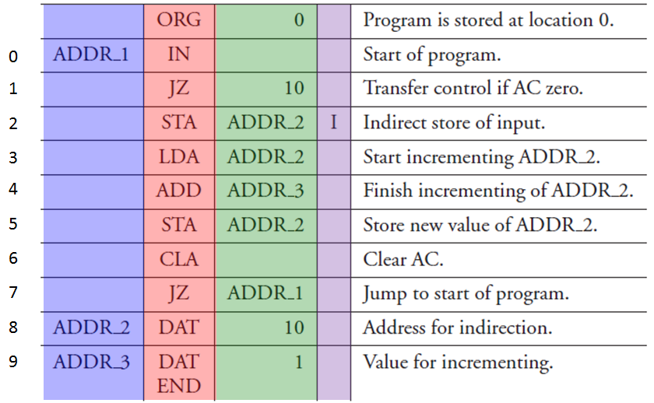
The 1st instruction following the ORG statement reads the input register value into the accumulator.
The 2nd instruction jumps to address 10 if AC==0, indicating that the last word of the program being loaded has been written into the memory.
The next executed instruction is in address 10; control is transferred to the second program.

Slide 14
If AC!=0, its value is stored (indirectly) at an address (value) stored at ADDR_2 memory address.
On the first execution of this command the value stored at memory address ADDR_2 is 10. The content of the accumulator is therefore stored at location 10.
The next 3 steps increment by 1 the value of ADDR_2 by placing its contents in the accumulator, adding the value in memory address ADDR_3 (=1) to it and storing the new value into memory address ADDR_2.

Slide 15
Finally, the accumulator is zeroed and a JZ instruction is used to return to address ADDR_1 (=0), the first address of the boot program.
The indirect STA instruction is not supported by the simple computer, but can be simulated by a self-modifying subprogram.
Though self-modifying programs are considered a bad programming practice, it illustrates the power of self-modification and the advantage of having indirection in the instruction set of a computer.

Slide 16
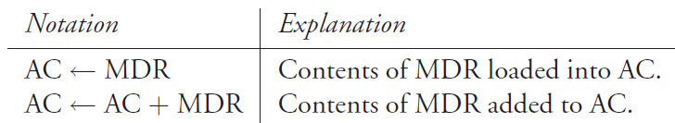


Timing and Control
We need to design circuits controlling the combining and movement of data.
Assignment notation is introduced.

Slide 17
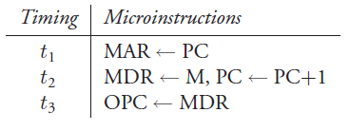


Register transfer notation uses these assignment operations as well as timing information to break down a machine-level instruction into microinstructions that are executed in successive microcycles.

Slide 18

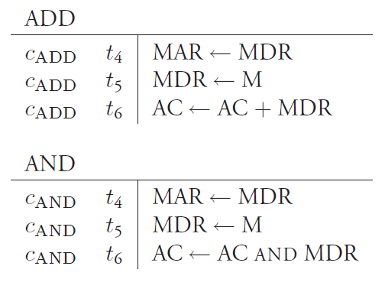

microinstructions for the execute portion

Slide 19
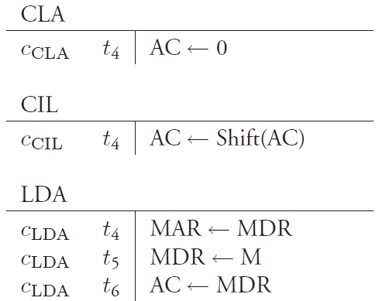

Slide 20
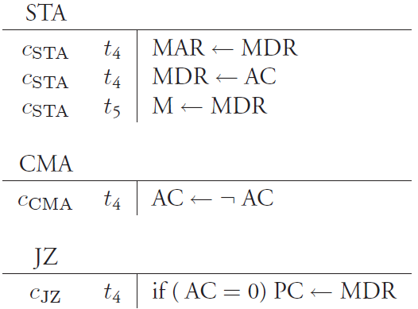

Slide 21
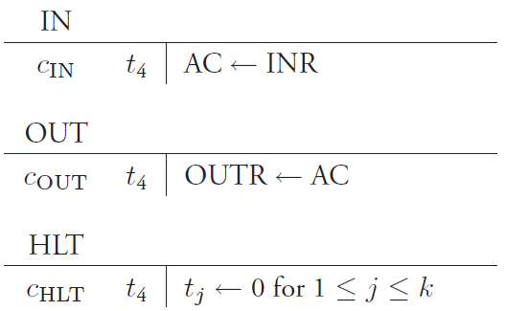

Slide 22
Generating Control Signals
Define control variables that control the movement of data between registers or combine the contents of two registers and assign the result to another register.
Associate a control variable L(A,B) if a microinstruction results in the movement of data from register B to register A, denoted A ← B.
L(OPC,MDR) = t3 : OPC is loaded with the contents of MDR when t3 = 1

Slide 23
Associate a control variable L(A,B ⊙ C) if a microinstruction results in the combination of the contents of registers B and C with the operation ⊙ and the assignment of the result to register A, denoted A ← B ⊙ C.
L(AC, AC+MDR) = cADD ∧ t6 : The contents of AC are
added to those of MDR and copied into AC when cADD ∧ t6 = 1.

Slide 24
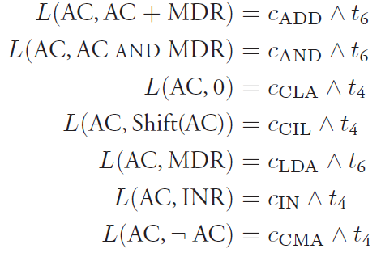

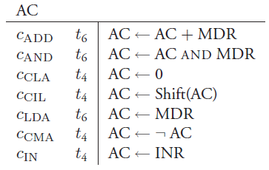
Control of Accumulator
Group together all the microinstructions affecting accumulator
Derive control variables

Slide 25
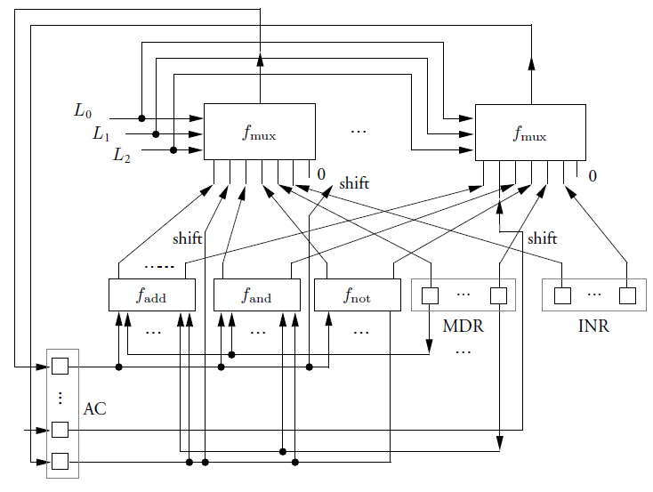
Hardware Implementation
16 7:1 MUXes
MUX 7:1
MUX 7:1
16-bit ALU
ADD
AND
NOT
16-bit registers

Slide 26

Execution of
MUX 7:1
MUX 7:1
ADD
AND
NOT

Slide 27
Execution of
MUX 7:1
MUX 7:1
ADD
AND
NOT

Slide 28
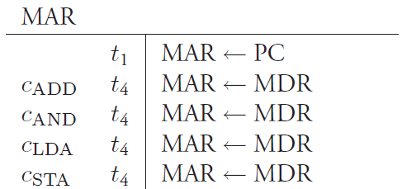

Group together all the microinstructions affecting MAR
Derive control variables

Slide 29
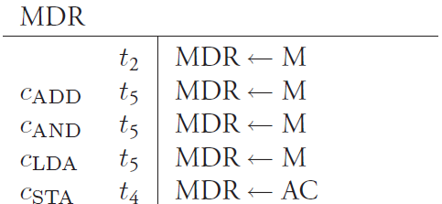

Group together all the microinstructions affecting MDR
Derive control variables
Quiz: What and how many MUXes are required?
Ans: 16 MUXes of 2:1

Slide 30
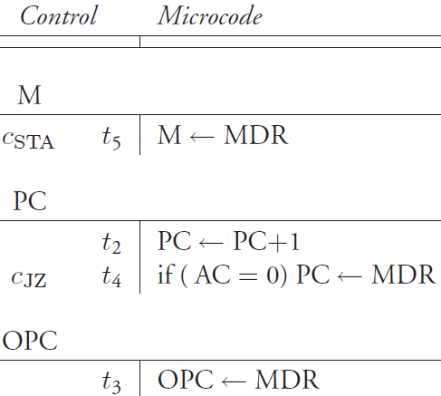
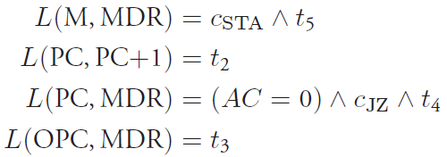
Group together all the microinstructions affecting a given register
Derive control variables

Slide 31

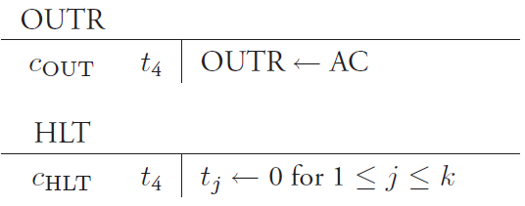

Group together all the microinstructions affecting a given register
Derive control variables

